Slide 1
Enhanced Reporting Requirements
Notes:
Testing notes

Slide 2
Enhanced Reporting Requirements
Finance Bill on 20th October 2022 introduced a requirement for returns by employers in relation to certain reportable expenses/benefits
Enhanced reporting is a new reporting requirement
Subject to commencement order - and will be introduced on a phased basis to begin on 1 January 2024

Slide 3
Enhanced Reporting Requirements
Building on principles of payroll reporting
- Report on or before the date of payment
Will allow for the provision of meaningful and effective high-level data to Department of Finance
Enhancement of Revenue’s Compliance Intervention Framework.
Diversion of resources and contacts away from compliant employers
Providing increased visibility and assurance to employees in relation to non-taxable payments.

Slide 4
Enhanced Reporting Requirements
ERR will leverage existing design principles
Revenue will provide a facility in ROS to enable employers to:
- submit, amend and correct ERR data
- check data at submission level
This will facilitate employers in submitting this information
Revenue will provide facilities to 3rd Party software providers to integrate with Revenue systems.
Functionality for employees to view the employer submissions in myAccount will be available in 2024

Slide 5
Enhanced Reporting Requirements
Expenses and Benefits to be reported from 1 January 2024
Travel & Subsistence (amount paid for each of the following)
Travel Vouched
Travel Unvouched
Subsistence Vouched
Subsistence Unvouched
Site Based Employees (includes Country Money)
Emergency Travel
Eating on Site
Small benefits – vouchers
Amount paid
(max 2 benefits cannot exceed €1,000)
Remote working relief
- Number of days
- Amount paid

Slide 6
Enhanced Reporting Requirements
Frequently asked questions
Only incurred expenses will be reported. The use of company credit cards or prepaid cards are not currently in the scope of ERR as it does not involve a payment in regard to T&S to the employee by their employer.
No reporting will be required outside of the definition of an employee or director as set out in legislation for payments made to people who are neither.
Fuel cards, toll tags, car insurance and motor tax if paid directly by the employer are not within the scope of reporting as no payment has been made to the employees or directors.

Slide 7
Enhanced Reporting Requirements
Frequently asked questions
Country money is included in Travel and Subsistence under site based employees.
There will be no requirement at present for the reporting of kilometres travelled for reporting of Travel.
Any payment made which exceeds the thresholds will be subject to the normal rules for taxable payments.

Slide 8
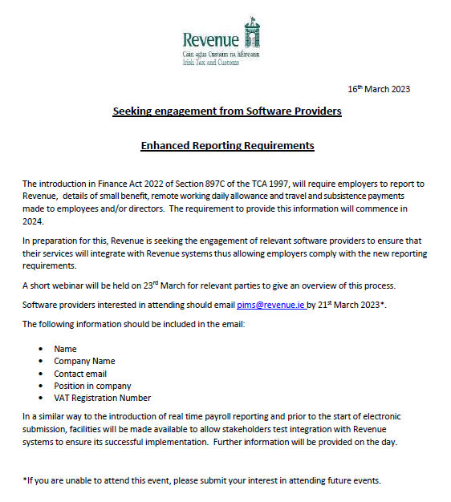
Enhanced Reporting Requirements
Copy of notice issued in March 2023 for engagement from Software Providers to attend service user group (SUG) meetings to discuss this reporting requirement.
We are urging employers to contact their software providers and advise them to engage with Revenue as soon as possible.
For anyone wishing to attend these meeting they should send their request to pims@revenue.ie

Slide 9
Enhanced Reporting Requirements
What's happening now:
Revenue systems – ongoing analysis and development
Extensive engagement has commenced with the relevant stakeholders below to ensure seamless integration with Revenue IT Systems:
Software providers
Employers and tax agents
Representative bodies

Slide 10
Draft Enhanced Reporting ROS Screens
Submit expenses and benefits by file upload

Slide 11
Submit expenses and benefits by file upload
Draft

Slide 12
Submit Expenses and benefits by file upload
Draft

Slide 13
Draft Enhanced Reporting ROS Screens
Submit expenses and benefits by online form

Slide 14
Submit expenses and benefits by online form
The following slides show the flow when submitting an online form
Draft

Slide 15
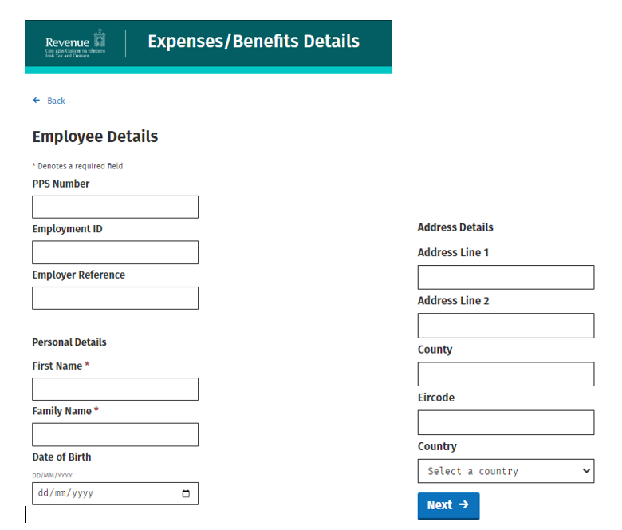
Submit expenses and benefits by online form
Depending on the information available the user will have to complete different fields when submitting a claim
Where a PPSN or employment ID are not available the following fields are completed.
>>Employer reference>> Personal Details>> Date of Birth and Address details
Where the PPSN and employment ID are available the following fields are completed
>>Employee details and Personal details
Draft

Slide 16
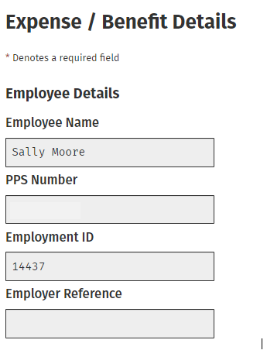
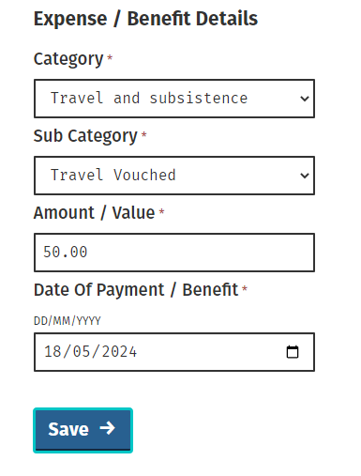
Submit expenses and benefits by online form
Draft

Slide 17
Submit expenses and benefits by online form
Draft

Slide 18
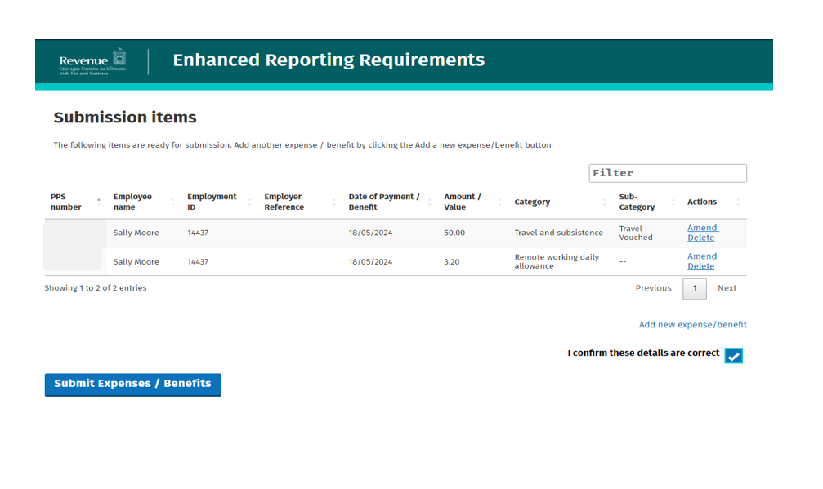
Submit expenses and benefits by online form
Draft
Draft

Slide 19
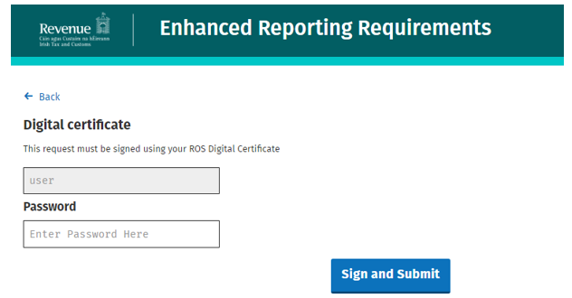
Submit expenses and benefits by online form
Draft

Slide 20
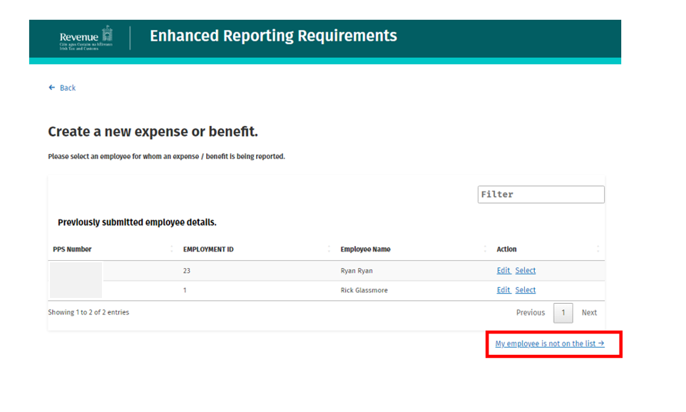
Submit expenses and benefits by online form
Draft
Draft

Slide 21
Submit expenses and benefits by online form
Draft
The above message will be displayed when the employer next logs on if they did not complete the submission. They will have the option to discard or accept the submission.

Slide 22
Further information
An ERR hub page has been created on the Revenue website and is located under:
employing people
becoming an employer and ongoing obligations
There is also a short URL www.revenue.ie/ERR

Slide 23
June Webinar
Ceasing Employments & Employment IDs
Non-Taxable Lump Sum Payments
Statement of Account
Bulk Transfers

Slide 24
Bulk Transfers
The Bulk Transfer of Employments facility was developed to facilitate employers who are transferring employees from one employer registration number to another linked employer registration number. Bulk Transfer requests should only be made for cases where more than 100 employees are to be transferred.
It ensures that the tax credits and rate bands of affected employees remain unchanged on transfer to the new employer registration number.
The facility is only for employers who are transferring all or a cohort of employees from their “old” employer registration number to their new employer registration number. It is not available for unconnected employers.

Slide 25
Bulk Transfers
Revenue provides a Bulk Transfer service where there is a valid reason for doing so. Employers should notify Revenue as early as possible of their intention to use this facility, as Revenue needs to schedule when the request can be processed. You should include the following details on an excel spreadsheet & submit through MyEnquiries:
Old Employer Registration number
New Employer Registration number
No. of employees
PPSNs of employees
Old employment ID & new employment ID
Cessation date under the old employer registration number
Commencement date under the new employer registration number
This request should be sent via MyEnquiries using the following category and subcategory :
Enquiry relates to: Employers PAYE
More specifically: Bulk Transfer of Employments Request

Slide 26
Ceasing Employments & Employment IDs
When an employee ceases employment it is the responsibility of the employer to submit the date of leaving to Revenue
When an employment ceases, the same Employment ID cannot be re-used in the same tax year
When an employment record is active in a current year & payroll has been submitted, the employer should not be correcting a submission in a previous year to add a date of leaving
Example: Joe starts employment on 07/03/2022, using employment ID1 & paid weekly. The employment continues into 2023 & payroll has been submitted. In March 2023, the employer completes a correction to a payroll in 2022 & adds a date of leaving 21/10/2022. This will also cease the record in 2023 but add a date of leaving 01/01/2023 as payroll has been submitted. This should not be done.
Revenue do not know why employers are completing the above correction

Slide 27
Ceasing Employments & Employment IDs
Where an employee ceases in a previous year, no date of leaving was submitted & no payroll has been submitted in the following year
An employer can go back & amend the last payroll submission in the previous year to add the correct date of leaving or submit a nil payroll with a date of leaving – the paydate on the nil submission should be the same as the final paydate for the employee.

Slide 28
Ceasing Employments & Employment IDs
If an employer is changing a frequency of pay, there should be no need to cease the employment record.
We are seeing cases where a pay frequency is being changed, the record is being ceased & employers are trying to use the same employment ID on the new record.
Problems arising from this:
Duplicate employment records with the same ID
Employer unable to retrieve the correct RPN
If the RPN is cumulative, previous pay & tax on the RPN can cause the employee to be double taxed on earnings as the employer has also all earnings recorded in the payroll

Slide 29
Ceasing Employments & Employment IDs
If the employer must cease the record to change the frequency of pay, they should
Use a new employment ID on the new record
Use the new start date for the record & not use the original start date
Employers should NOT:
Record the previous pay & tax in the payroll software – the previous pay & tax will populate of the RPN

Slide 30
Non-Taxable Lump Sum Payments
If an employer is paying an employee a non-taxable lump sum it must be recorded correctly in payroll.
If the payment is included in Gross Pay & not included in Taxable Pay it should be recorded in the Non-Taxable Lump Sum field.
The employer must determine if the payment meets the qualifying conditions to be a non-taxable payment.
More information on lump sum payments can be found on the Revenue website & Employers Guide 42-04-35A

Slide 31
Statement of Account
We are aware there are issues surrounding the requesting of Statements for Employers PAYE/PRSI through ROS
In the interim, if an employer/agent requires a Statement they can send a request through myenquires detailing the period/s required.
Alternatively, the employer/agent has access to this information on ROS:
ROS homepage (my services tab)
Employer Services
Returns – Statement of Account
Select the relevant year & month
On the left-hand side click on Monthly Return & all transactions are visible

Slide 32
